Slide 1
CS 540 Network Architecture
Lecture 4: Mobility
Prof. Younghee Lee

Slide 2
Mobility
Which layer can deal with mobility problem?
Physical layer?
limited
Link layer?
Campus wifi, Wibro(L2 Handover Scheme) : only limited sub-network area
Network layer?
Mobile IP: indirection
Transport layer?
End to end architecture
TCP Migrate: dynamically re-bind endpoints => good for big, less frequent movement, no network level modifications
Application layer?
Web browser
Internet Message Access Protocol(IMAP): Unlike POP, it allows multiple clients simultaneously connected to the same mailbox

Slide 3
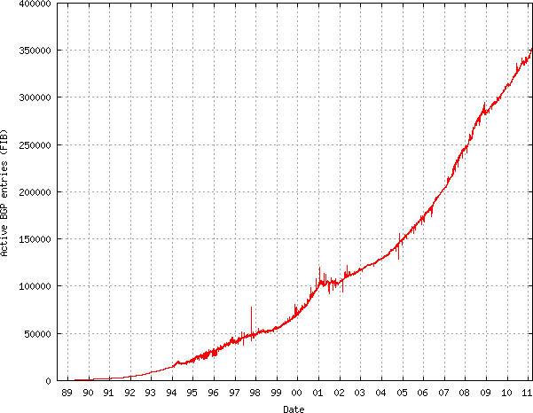
IP Mobility problem
IP address
- Loc. + id
Problems of IPv4
RIB/FIB Size
Multi-homing
Mobility
IPv4 Exhaustion
A solution : Identifier/Locator split or Mobile IP
Frequent Deaggregation due to Multihoming and Mobility
* Some part of this teaching materials are prepared referencing the material presented by David Freedman – Network Manager Claranet Technology Group

Slide 4
Discussion
Hi3: HIP + i3
SDN for redirection? or indirection?
Compatibility
Cost to build infrastructure
Your preference
How to lead to universal solution?
HIP: NAT, firewall … Can preserve their own role with HIP?

Slide 5
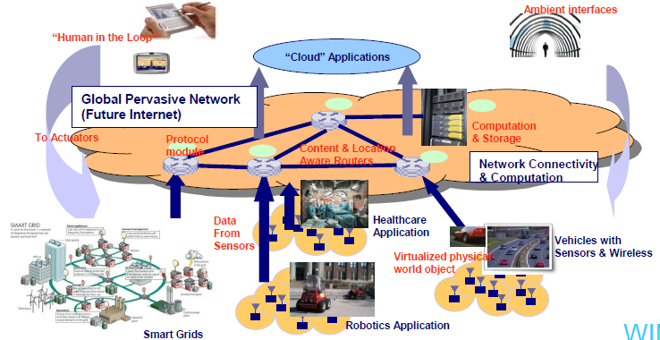
MobilityFirst
MobilityFirst
A Robust and Trustworthy Mobility-Centric Architecture for the Future Internet
Vision: Emerging “mobile Internet” usage scenarios – pervasive/M2M/IoT Sensor Networks
* Some part of this teaching materials are prepared referencing the material presented by D. Raychaudhuri WINLAB, Rutgers University, PIMRC Keynote, Sept 13, 2011

Slide 6
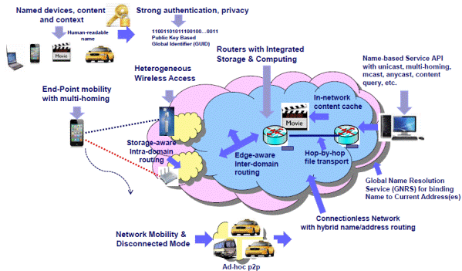
MobilityFirst : http://mobilityfirst.winlab.rutgers.edu/
(1) separation of naming and addressing, implemented via a fast global dynamic name resolution service
(2) self-certifying public key network addresses to support strong authentication and security
(3) generalized delay-tolerant routing with in-network storage for packets in transit
(4) flat-label internetwork routing with public key addresses
(5) hop-by-hop transport protocols operating over path segments rather than an end-end path
(6) a separate network management plane that provides enhanced visibility
(7) optional privacy features for user and location data
(8) an integrated computing and storage layer at routers to support programmability and evolution of enhanced network services.

Slide 7
Conclusion
Problem of ip mobility
Hierarchical addressing
Solution?
flat addressing
Arch. of flat addressing? : public key? Any other candidate?
DNS?
Future: IoT ➔ so many mobile node
Things connected to Cellular network, MANET, AP….

Slide 8
Reading Assignment
Alexander Afanasyev et al., “BGP Routing Table: Trends and Challenges”
Tian Bu et al., “On Characterizing BGP Routing Table Growth”
Submit 1 page report online via KLMS by 6pm Sep. 21 which is the day before the lecture of Sep. 22 (Thur.)
Submit also 1 page report (hard copy) at the beginning of the lecture of Sep. 22 (Thur.) as attendance check and for discussion

Slide 9
Mobile IP Operation (FYI)
Agents advertise their presence.
Using ICMP or mobile IP control messages
Mobile host can solicit agent information
Mobile host can determine where it is
Registration process: mobile host registers with home and foreign agent.
Set up binding
Tunneling
forward packets to foreign agent
foreign agent forwards packets to mobile host
Supporting mobility
invalidating old caches in a lazy fashion
Triangular problem
Home
Agent
Source
Foreign
Agent 1
Foreign
Agent 2

Slide 10
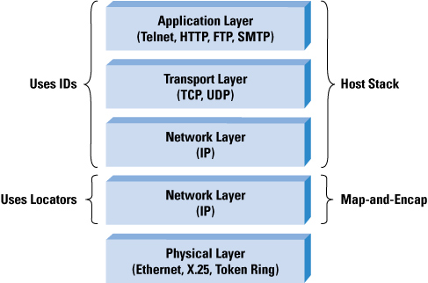
LISP
Host Stack:
supplies IDs
Locator/(Endpoint)ID Separator Protocol
IETF LISP WG: RFC6830
Cisco, US
Edge-Core network separation (EID-RLOC)
Topological Routing Locators (RLOCs) for routing
Network Based Map and Encap Solution
encapsulation between routers at the "edge" of the Internet
topological aggregation of the routable addresses (LOCs)
With portable numbering of end systems (EIDs)(Separate id space)
No changes to hosts, no new addressing changes to site devices
Router:
supplies RLOCs
by adding new
header
Network Level Solution

Slide 11
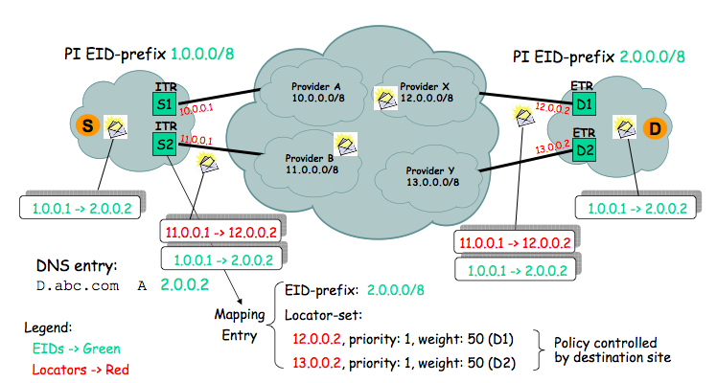
LISP Data plane
Ingress Tunnel Router (ITR)
Egress Tunnel Router (ETR)

Slide 12
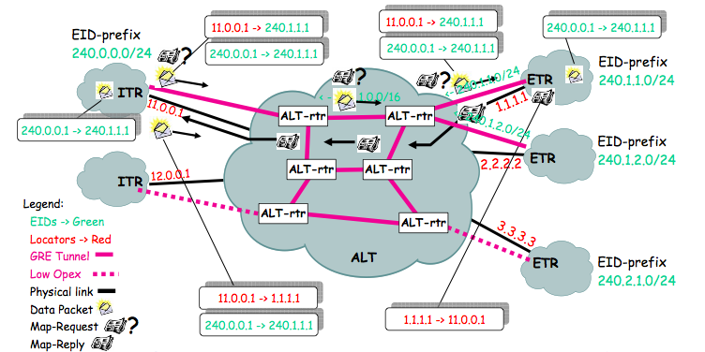
Mapping EID -> RLOC : Control Plane
ALT = The ALTernative network
an instance of BGP that carries EID prefixes
ALT mapping signals ETR for ITR
ETRs advertise EID-prefixes into the ALT to attract Map-Requests
ITRs use the ALT to route Map-Requests to the ETRs that are authoritative for an EID prefix
ETRs return Map-Replies on the underlying network to the requesting ITR
The ITR can now LISP-encapsulate packets directly to the destination’s ETR: GRE
Problem: requires global query server network
Ingress Tunnel Router (ITR)
Egress Tunnel Router (ETR)
GRE: Generic Routing Encapsulation

Slide 13
TCP connection Migration
The Migrate Internet Mobility Project:
enabling technology for MIT’s oxygen project(Pervasive computing)
Approach
Locates hosts through existing DNS :
LISP: global query server network
Secure Domain Name System Dynamic Update: RFC 2137
Seamless connectivity through connection migration
Follow from the e2e arguments
No IP support
have transport layer dynamically re-bind endpoints
Join together two separate connections
By unifying the context space: reference previous connection with token
Initial SYN a-> : SYN/ACK <-b: ACK(with data) a-> : normal data transfer : Migrate SYN a-> : Migrate SYN/ACK <-b : ACK(with data) a->
Special SYN packets include a Migrate option: Migrate SYNs do not establish new connections, but migrate previously-established ones
a
b

Slide 14
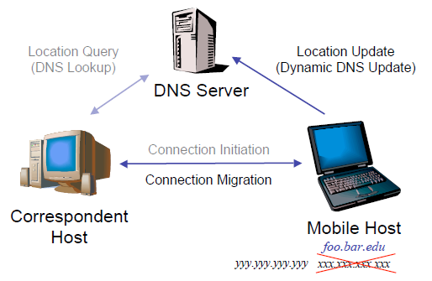
Migrate approach
Slide from Alex Snoeren, MIT

Slide 15
TCP connection Migration
The Migrate Internet Mobility Project:
enabling technology for MIT’s oxygen project(Pervasive computing)
But
Requires TCP support : only work for TCP
Slower than link-layer migration

Slide 16
HIP
The Host Identity Protocol
Invasive IP stack changes
Original goal:
to associate secure identities with hosts via cryptography (IPSec ESP)
End-To-End Communications via HIP secure id
ID/Loc split from security perspective in addition.
HIT : Host Identity Tag
128bit long hash value: hash on public crypto key!
Transport sockets bound to HITs not IPs
Kernel translates HIT - > IP
decoupling of the transport layer from the internetworking layer
Host Level Solution

Slide 17


HIP
Process
Process
Transport
<IP Address, Port>
Transport
<Host ID, Port>
Host Identity
<Host ID>
New waist
IP layer
<IP Address>
IP layer
<IP Address>
Link layer
Link layer

Slide 18
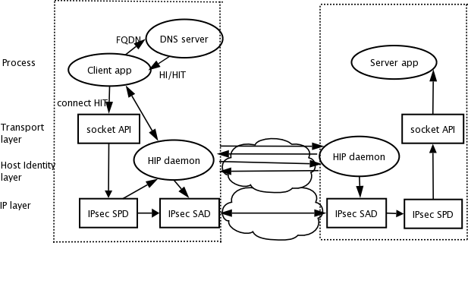
HIP
Multi-Homing
The binding between host identity and IP is dynamic and can have a one-to-many relationship
Multi-homing with multiple network interface(IP address)
Provide implicit HI → IP mapping through FQDN → HI and FQDN → IP
Diffie-Hellman key exchange
Mobility
Ipsec: KE for e2e ESP
+ signal protocol
a signal protocol between the communicating end points
IPsec ESP
Security

Slide 19
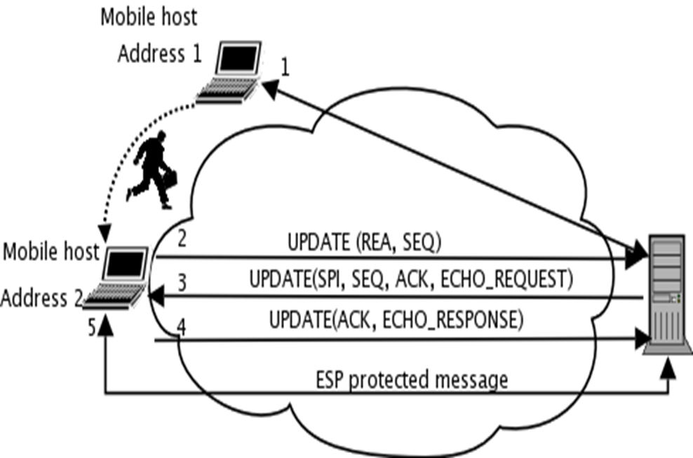
HIP
Changing address: sending a readdressing message

Slide 20
HIP
End to End Security
Secure Mobility / Multi-homing
IP address changes invisible to upper layers
transport layer connections survive address changes
IPv4 / IPv6 Interworking
Connection established using a four-way handshake; the HIP base exchange
proof of identity, IPsec setup, DoS attack protection
Kernel Support in FreeBSD, Linux, OpenSolaris, Windows

Slide 21
Transport layer mobility
One host moves => easy:
but both of end hosts move? => NEED RECONNECTION
Good on big less frequent movement: compared to link, network level mobility

Slide 22
ILNP
Identifier Locator Network Protocol
University of St Andrews, UK
128bit IPv6 address -->
64bit LOC
names sub-networks, equivalent to an IP routing prefix,
used by kernel to route transport binding to IP endpoint
64bit ID
names nodes, not interface
TP layer uses
a richer set of namespaces
Dynamic DNS as ID:LOC mapping system
a clean solution for the architecture?
Host Level Solution

Slide 23
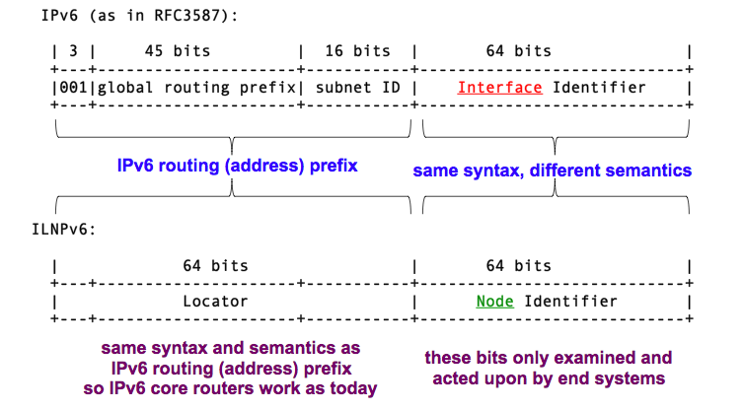
ILNPv6 Partitioning

Slide 24
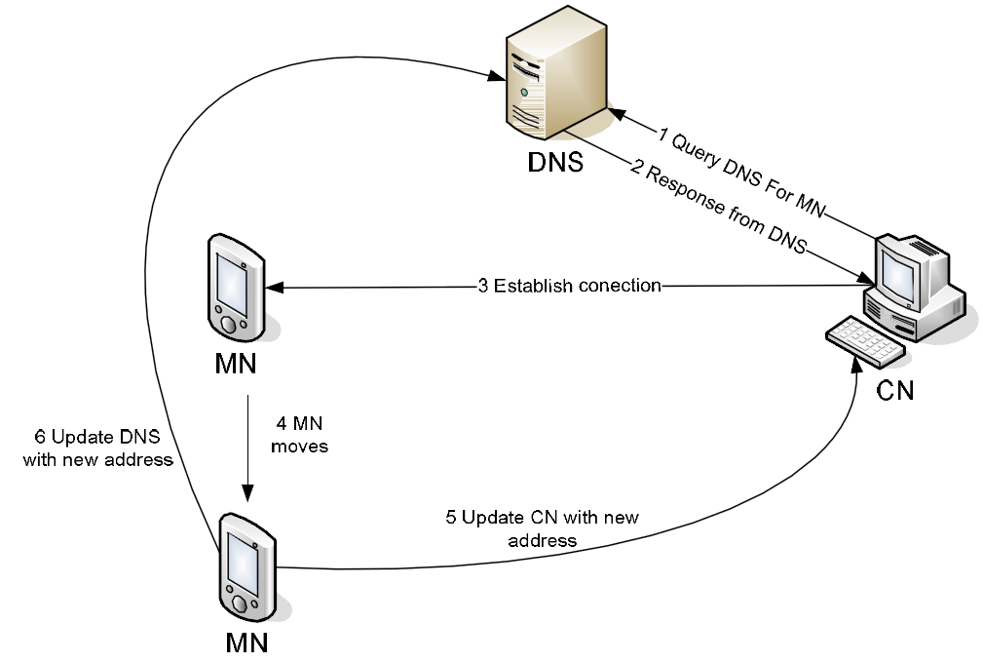
Mobility in ILNPv6
CN
Uses DNS to find MN’s set of Identifiers and Locators
MN
When the MN moves:
ICMP Locator Update (LU) to inform other nodes of revised set of Locators for the MN
Secure Dynamic DNS Update to revise its LOC in its Authoritative DNS server
Avinash Mungur, “Analysis of Locator Identity Split Protocols in Providing End-host Mobility,” Lancaster University

Slide 25
LISP vs. HIP, ILNP
Feature | LISP | HIP | ILNP
Maturity | Production | Production (almost) | Experimental
Changes | Network | Host | Host
Site Renumber | No | Optional | Optional
Network Build | Yes | No | No
Network MTU | Increase | Retain | Retain
Reduce RIB/FIB | Yes | Yes | Yes
Mechanism | Mapping System | Inter Host | DNS
Modify Apps? | No | No | No
IPv4 | Yes | Yes | No
IPv6 | Yes | Yes | Yes
SiteMultihoming | Yes | Yes | Yes
Host Multihoming | No | No | Yes

Slide 26
LISP vs. HIP, ILNP
Feature | LISP | HIP | ILNP
Multicast | Yes | Yes | Yes
Traffic Engineering | Yes | Yes | Yes
Local Addressing | No | No | Yes
Mobile Hosts | No | Yes | Yes
Mobile Nets | No | No | Yes
Multipathing | No | No | Yes

Slide 27
I3: Internet Indirection Infrastructure
For mobility, multicast, anycast…
Add an indirection layer on top of IP, implemented using overlay networks
Rendezvous based
send(R, data)
send(ID, data)
Sender
trigger
Receiver (R)
Triggers periodically refreshed by end-hosts
ID length: 256 bits
ID
R
IP router
i3 node
From slides of Prof. Ion Stoica, UC Berkeley

Slide 28
I3: Routing (DHT)
R inserts trigger t = (37, R); S sends packet p = (37, data)
An end-host needs to know only one i3 node to use i3
E.g., S knows node 3, R knows node 35
S
i3 node
2^{m-1}
0
S
3
send(37, data)
20
7
7
Chord circle
3
37
R
35
41
41
20
trigger(37,R)
37
R
35
send(R, data)
R
R
From slides of Prof. Ion Stoica, UC Berkeley

Slide 29
I3: Internet Indirection Infrastructure
send(R1, data)
Longest matching prefix
send(id,data)
send(R1,data)
p: prefix
a: suffix
Sender
id
R1
Receiver (R1)
Receiver (R1)
send(p|a,data)
p|s₁
R1
id
R2
Sender
p|s₂
R2
send(R2, data)
Receiver (R2)
Receiver (R2)
p|s₃
R3
Randomly chosen suffix ? =>
Load balancing
Multicast
Anycast
Receiver (R3)
send(id,data)
send(R1, data)
send(id,data)
send(R2, data)
Receiver
(R1)
Sender
Sender
id
R2
id
R1
Receiver
(R2)
Mobility
From slides of Prof. Ion Stoica, UC Berkeley

